Slide 1


Microsoft Power BI Module 1 - Introduction to Power BI

Slide 2
Agenda
What is Business Intelligence?
Bl Use Cases
Why Power Bl?
Stages of Business Intelligence
Various Bl Tools
Introduction to Power Bl
Power Bl Components
Building Blocks of Power Bl
Power Bl Desktop
Creating Reports in Power Bl
Power Bl Pricing
Architecture of Power Bl
Power Bl Desktop Installation

Slide 3
What is Business Intelligence?

Slide 4
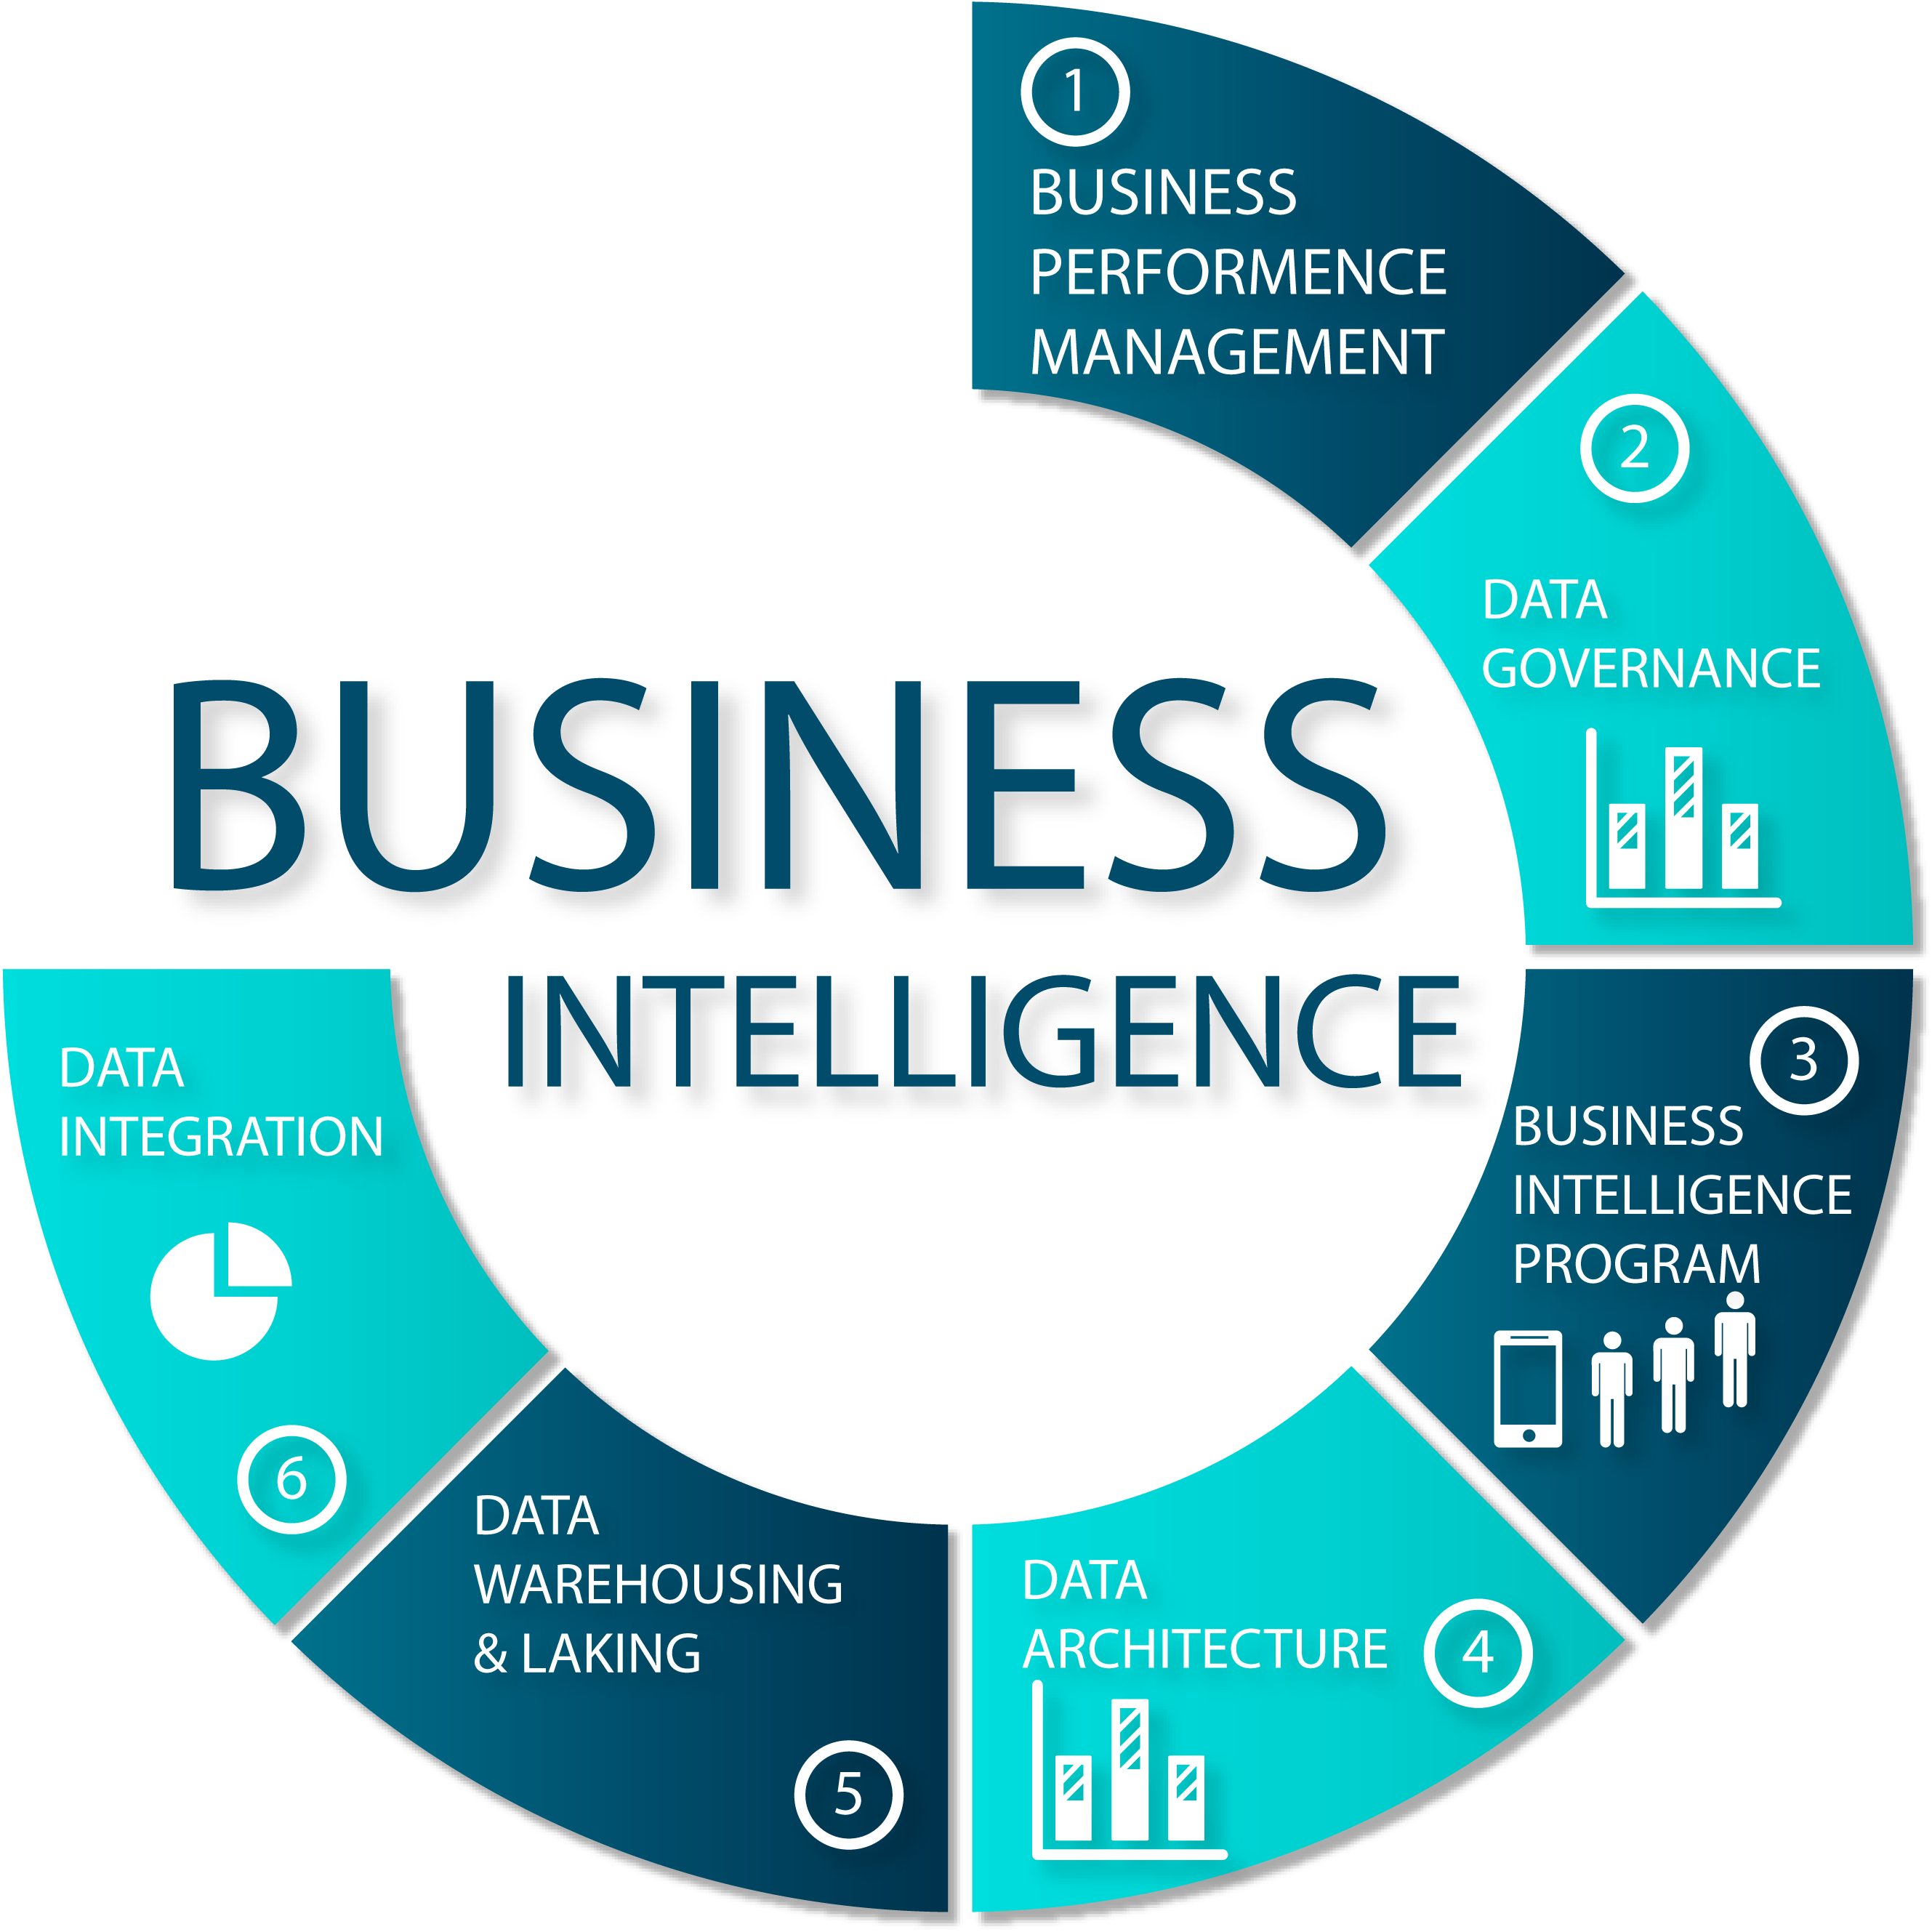
Business Intelligence?
Business Intelligence (Bl) is a set of processes, architectures, and technologies that help in the collection, integration, analysis, and presentation of business information. The purpose of Business Intelligence is to enable stakeholders make better business decisions

Slide 5
Stages of Business Intelligence

Slide 6
Stages of Business Intelligence
Business Intelligence is generally divided into four stages:
Collection
data cleaning
reporting/visualization
Decision Making/Prediction

Slide 7
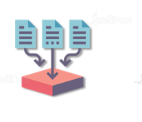
Collection
data cleaning
reporting/visualization
Decision Making/Prediction
Collection
Data is collected either from the existing sources, such as ERP data, company database, etc., or externally through polls, forms, and others

Slide 8
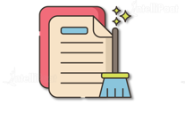
Collection
data cleaning
reporting/visualization
Decision Making/Prediction
Data Cleansing
Identifying irrelevant parts of the data and modifying, deleting, or replacing the coarse data.

Slide 9

Collection
Data Cleaning
reporting/visualization
Decision Making/Prediction
Reporting/Visualization
Graphical representation of data using visual elements such as charts, graphs, tables, etc.

Slide 10
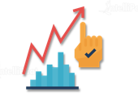
Collection
data cleaning
reporting/visualization
Decision Making/Prediction
Decision Making/Prediction
The last stage is making business decisions and monitoring and predicting business trends based on the report developed

Slide 11
BI Use Cases

Slide 12
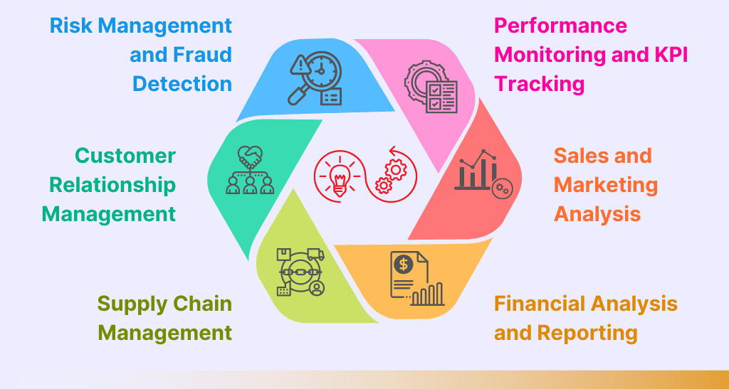
BI Is everywhere!

Slide 13
Data Semantics

Slide 14
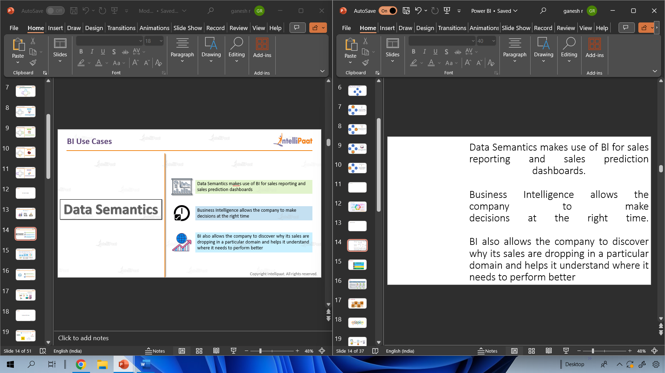
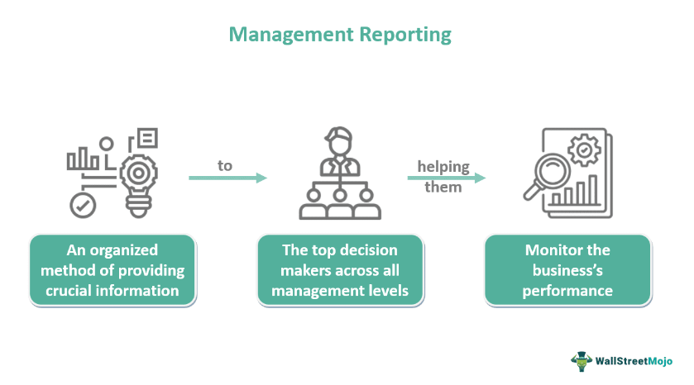
Data Semantics makes use of Bl for sales reporting and sales prediction dashboards. Business Intelligence allows the company to make decisions at the right time. BI also allows the company to discover why its sales are dropping in a particular domain and helps it understand where it needs to perform better

Slide 15
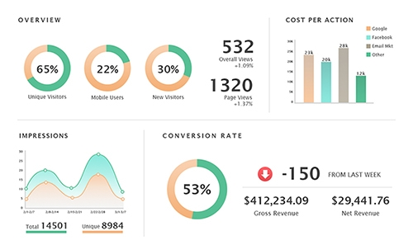

Slide 16


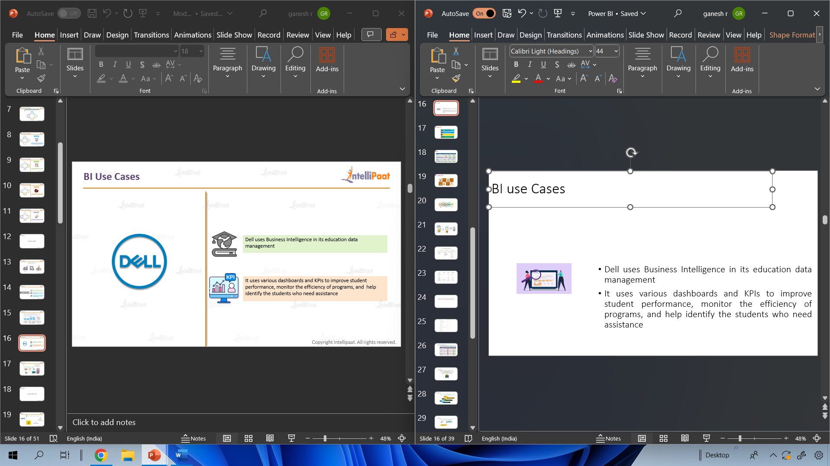
BI use Cases
Dell uses Business Intelligence in its education data management
It uses various dashboards and KPIs to improve student performance, monitor the efficiency of programs, and help identify the students who need assistance

Slide 17


Slide 18
Various BI tools

Slide 19
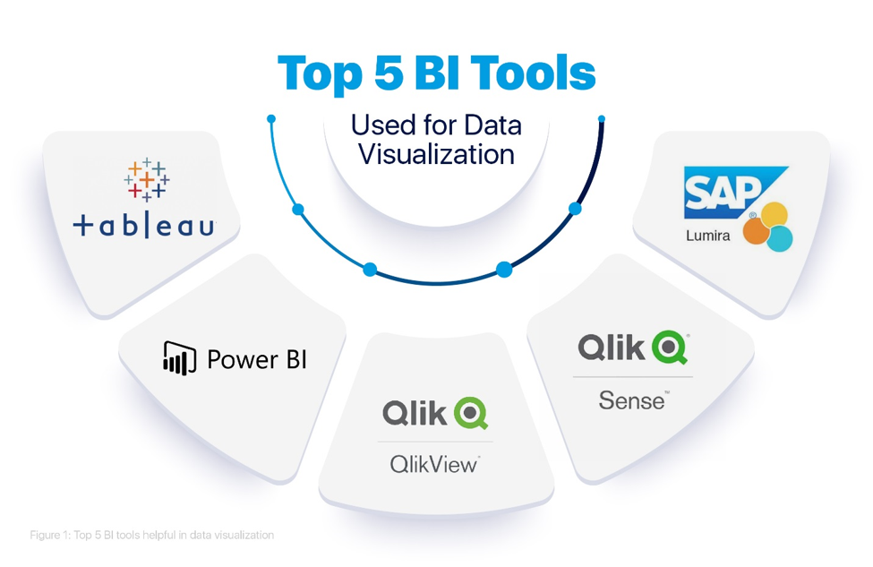
These are the most commonly used BI tools

Slide 20
Why Power BI

Slide 21
Why Power BI?
Affordability
Natural Language Query
Real-time Streaming
Custom Visualization

Slide 22
Why Power BI?
Affordability
The Power Bl Desktop version is available for free, which can be used for report building on a computer. If we want to use more Power Bl services, then we can buy Power Bl Service at an affordable cost
01Affordability
02Natural Language Query
03Real-time Streaming
04Custom Visualization

Slide 23
Why Power BI?
Natural Language Query
This feature allows users to type questions and get answers in a user-specific format. This is mainly useful in getting quick insights from data
01Affordability
02Natural Language Query
03Real-time Streaming
04Custom Visualization

Slide 24
Why Power BI?
Real- time Streaming
This feature allows users to stream real-time data and update
dashboards in real time, which helps them make timely business
decisions
01Affordability
02Natural Language Query
03Real-time Streaming
04Custom Visualization

Slide 25
Why Power BI?
Custom Visualization
Power BI has visualizations that are made by developers for specific use cases. These custom visualizations are available in Power Bl Marketplace
01Affordability
02Natural Language Query
03Real-time Streaming
04Custom Visualization

Slide 26
Introduction to Power Bl

Slide 27
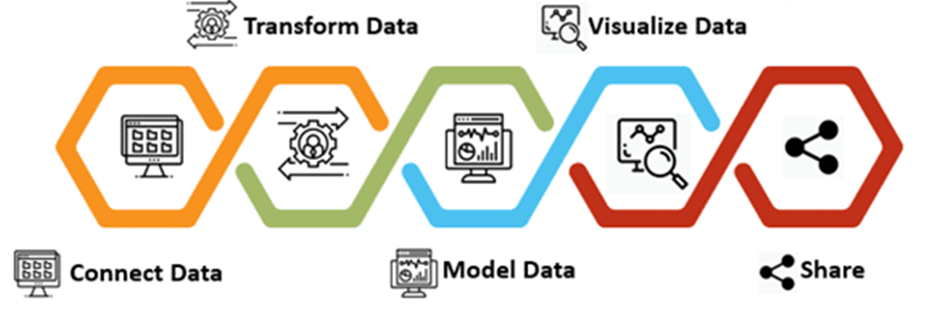
Introduction to Power Bl
Power Bl is a Business Intelligence platform, which provides tools for aggregating, analyzing, visualizing and sharing data.

Slide 28
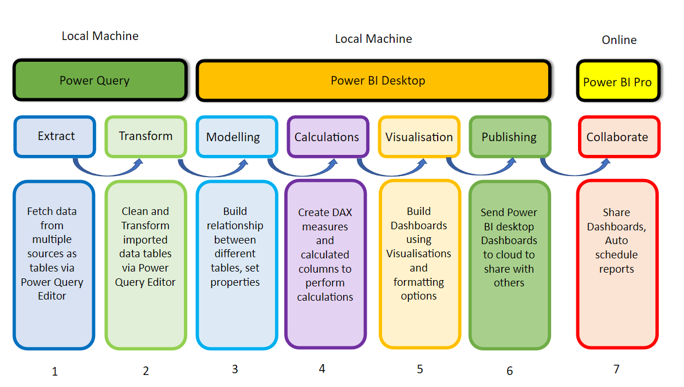

Slide 29
Power Bl Components

Slide 30
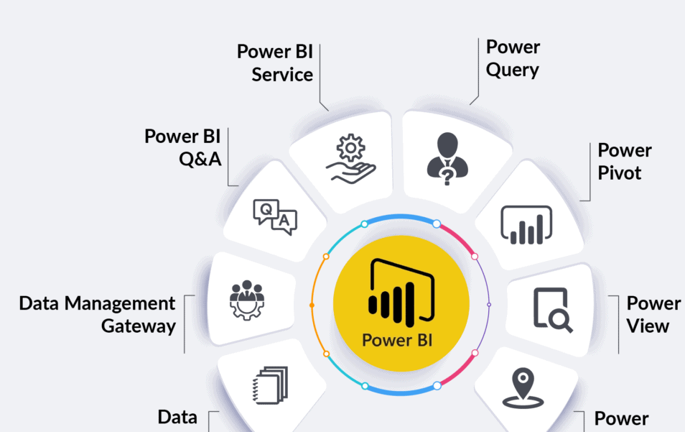
Power Bl Components

Slide 31
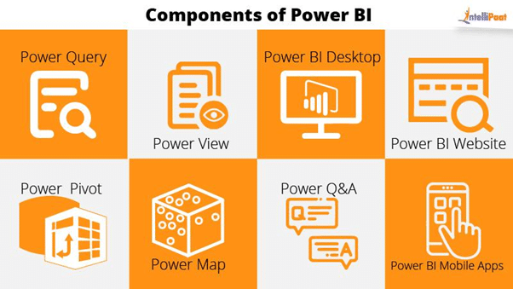

Slide 32
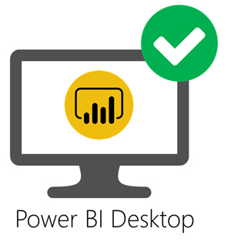

Power Bl Components
Power Bl Desktop
It is a free application that helps us connect to multiple data sources and transform and visualize our data
Power BI Service
It is a cloud-based service where users view and share their reports and dashboards

Slide 33
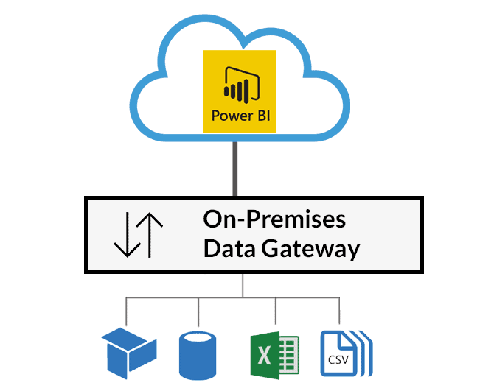
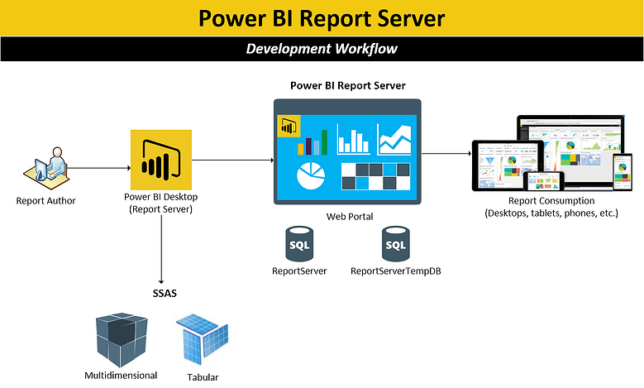
Power Bl Components
Power Bl Gateway
It is mainly used for scheduled data refresh
Power Bl Report Server
It is an on-premises web interface and an alternate for Power Bl Service

Slide 34
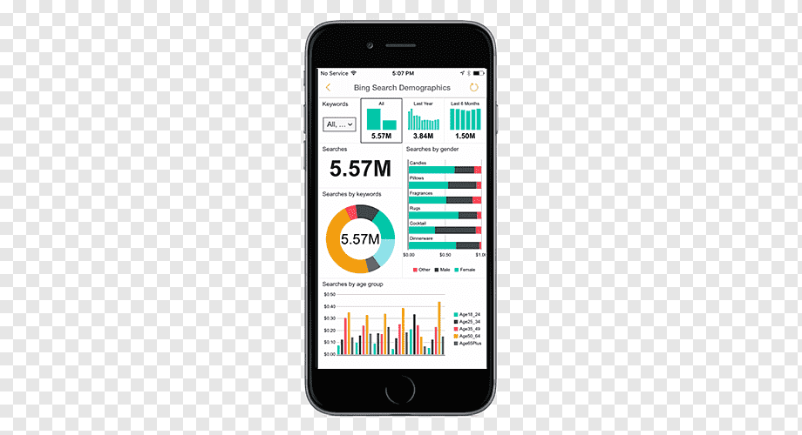

Power Bl Components
Power Bl Mobile App
Power Bl offers a set of mobile apps for Android, iOS, and Windows mobile devices through which users can securely access and view their live dashboards and reports
Power Query
Power BI accepts data from a variety of other data sources such as excel. Power Query allows you to search data from various sources such as social media websites, big data and so on.

Slide 35
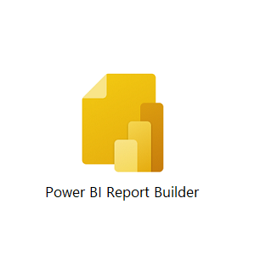

Power Bl Components
Power BI Report Builder
It helps in developing paginated reports such as invoices, receipts, delivery notes, etc.
Power Bl Embedded
It helps in the integration of Bl reports with other applications

Slide 36
Power BI Pricing

Slide 37
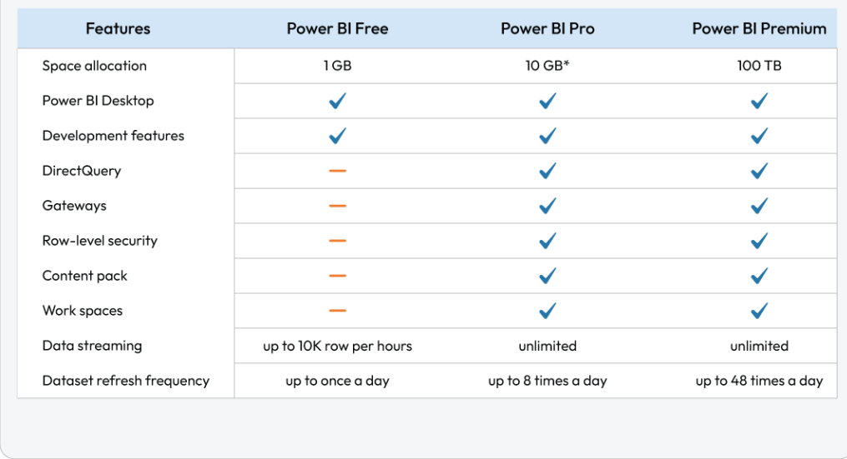
Power BI Pricing

Slide 38
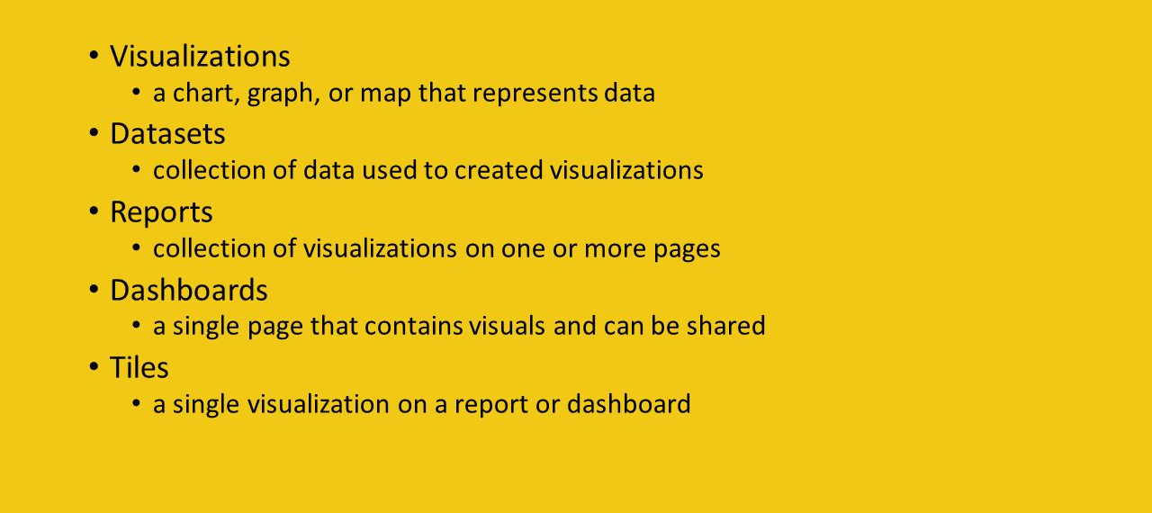
Building Blocks of Power Bl

Slide 39
Architecture of Power Bl

Slide 40
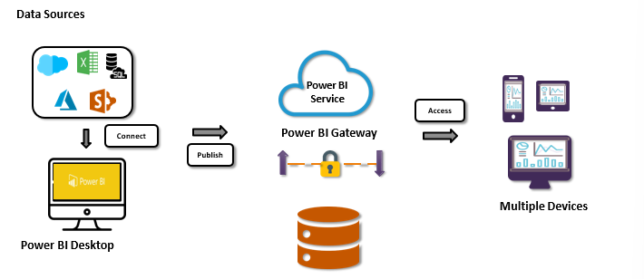
Architecture of Power Bl

Slide 41
Power Bl Desktop

Slide 42
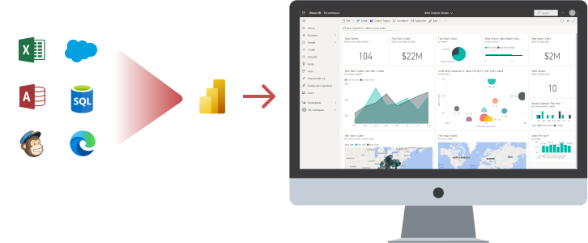
Power Bl Desktop
Power Bl Desktop combines Microsoft Query Engine (M) with visualization and data modelling for creating interactive reports.

Slide 43
Power Bl Desktop Installation

Slide 44

Power Bl Desktop Installation
Go to Microsoft's official website, and select Power Bl Desktop.
Select the language of your choice to download Power Bl.
Choose the file based on your operating system.
Then, download and install it on your local machine.

Slide 45
Demo: Installing Power Bl Desktop

Slide 46
Creating Reports in Power Bl

Slide 47
Creating Reports in Power BI
The three-step process in creating reports in Power Bl are:
Connect to Data Sources
Transform Data into a Model
Add Visualization

Slide 48
Creating Reports in Power BI
Connect to Data Sources
With Power Bl Desktop, we can connect to many different data sources to collect data
Connect to Data Sources
Transform Data into a Model
Add Visualization
SaaS
connections
Connectors
Data
Sources
Azure Data

Slide 49
Creating Reports in Power BI
Transform Data into a model Connect to Data Sources
Power Query Editor in Power BI Desktop Helps Us transform the Data into a Model
Connect to Data Sources
Transform Data into a Model
Add Visualization
Group by
Fill
Transpose
Merge
Pivot and Unpivot

Slide 50
Creating Reports in Power BI
Add Visualization
Data visualizations bring data to life, using colours and shapes
Connect to Data Sources
Transform Data into a Model
Add Visualization
Cards
Charts
Maps
Trees
Tables

Slide 51
Demo: Creating a Report in Power Bl

Slide 52
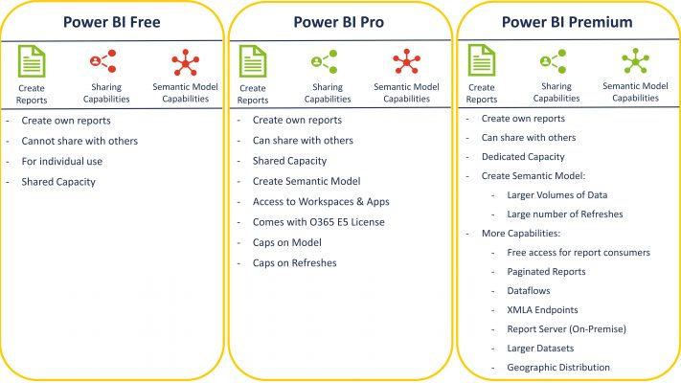
Power Bi License Types

Slide 53
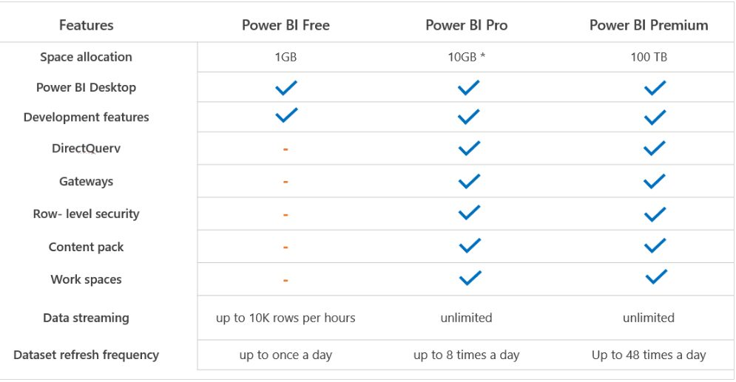

Slide 54
Power Bi Workspace Roles

Slide 55
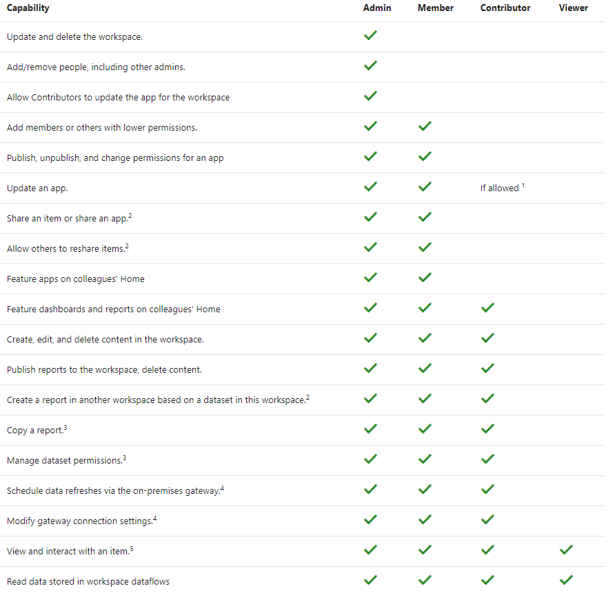

Slide 56
SQL Server Report Services vs Power BI Report Server vs Power BI Service

Slide 57
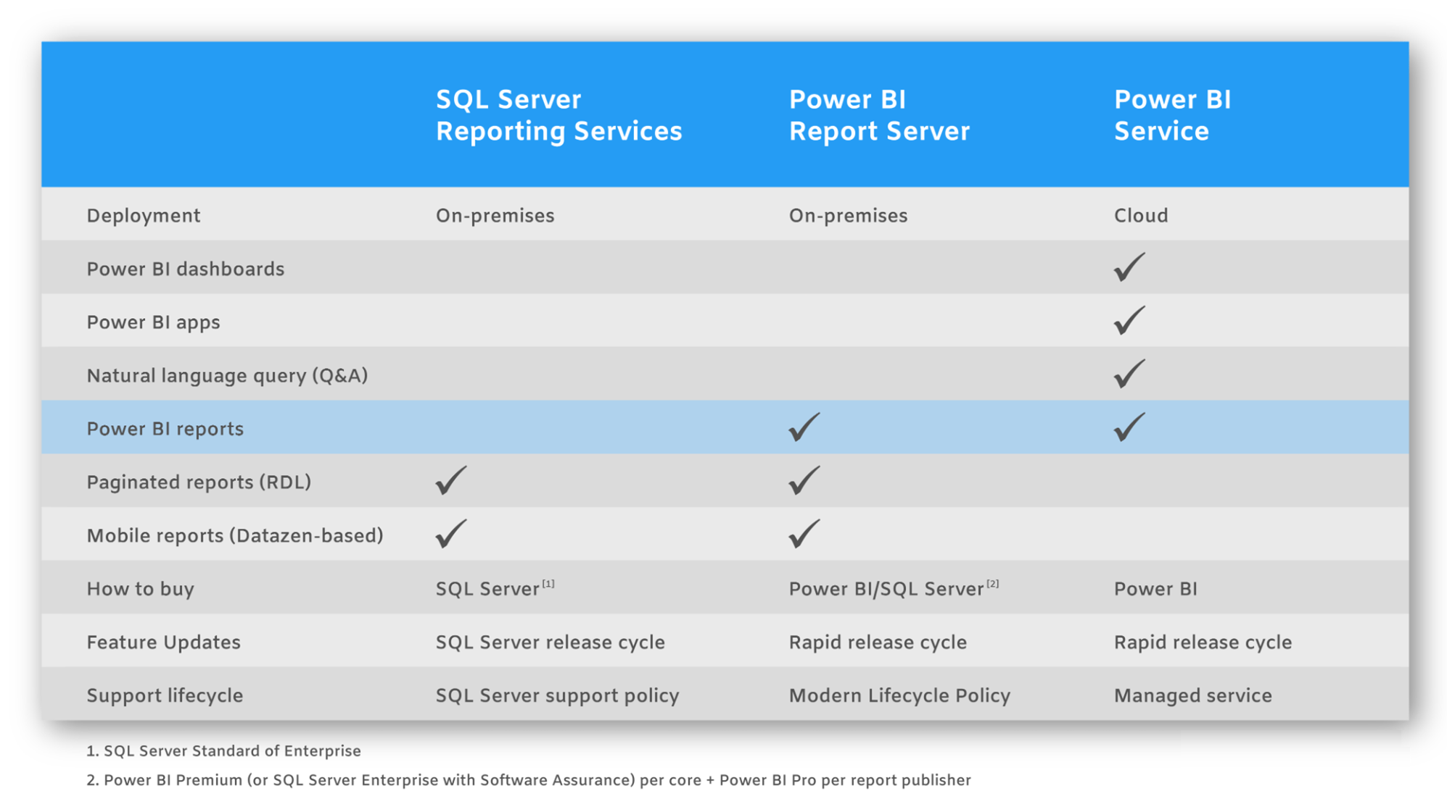

Slide 58
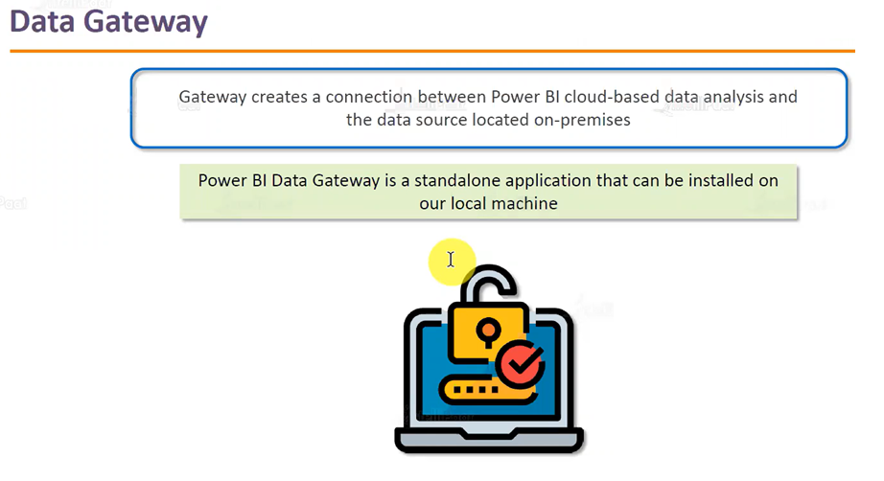

Slide 59

Keeps our reports and dashboards up to date.
Offers one gateway for all our cloud services.
Secures data transfer.

Slide 60
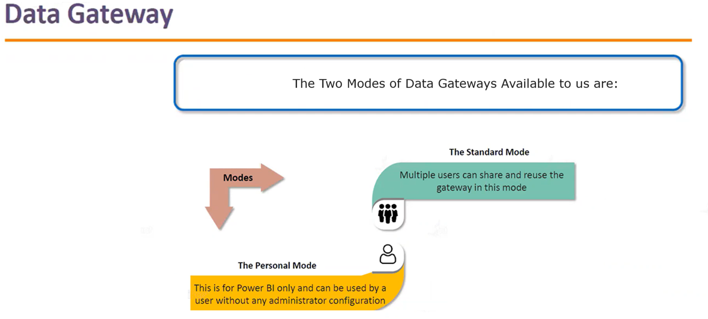

Slide 61
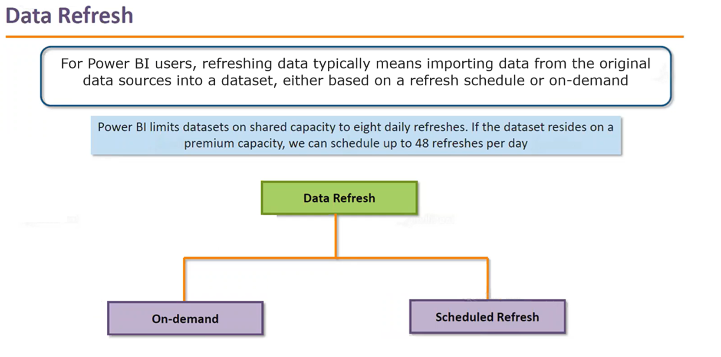

Slide 62
Data Refresh
Power BI Refresh Types
Storage Mode | Data Refresh | OneDrive Refresh | Query Caches | Title Refresh | Report Visual
Import | Scheduled and On-Demand | Yes | If enabled on premium capacity | Automated and On-Demand | No
DirectQuery | Not Applicable | Yes | If enabled on premium capacity | Automated and On-Demand | No
Live Connect | Not Applicable | Yes | If enabled on premium capacity | Automated and On-Demand | Yes
Push | Not Applicable | Not Applicable | Not Applicable | Automated and On-Demand | No

Slide 63
Upgrade every month data gateway.

Slide 64
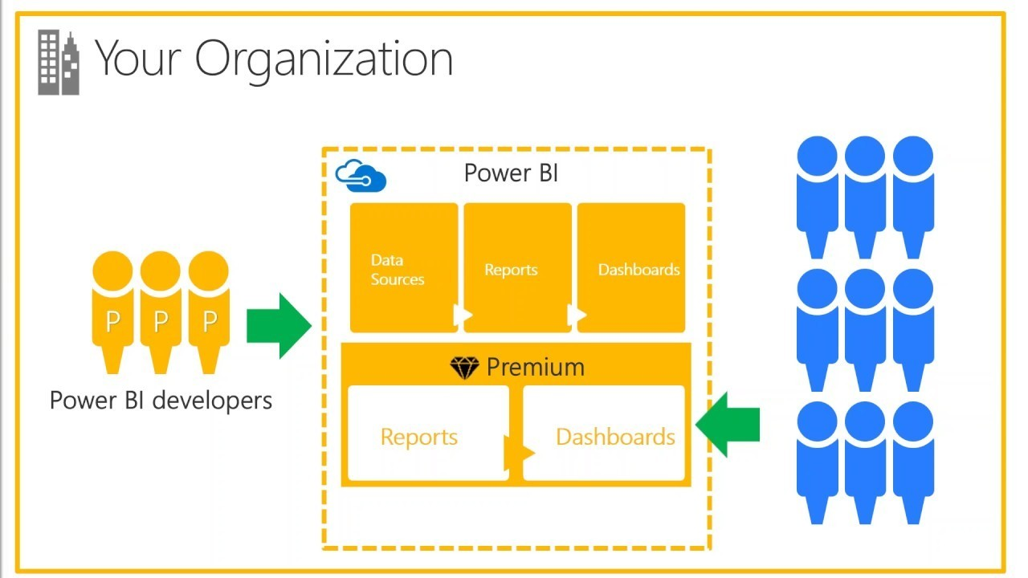
Introduction to Power BI Premium
What is Power BI Premium?
Power BI Premium, is simply a licensing plan that covers limitations of power BI pro Account. It is a licensing plan that helps overcome what you couldn’t easily achieve with power BI Pro account.
Power bi premium to access features and capabilities only available in premium. And offer greater scale and performances for power bi content in your organization.
Power BI Premium enables more users in your organization to get the most out of Power BI with better performance and responsiveness.

Slide 65
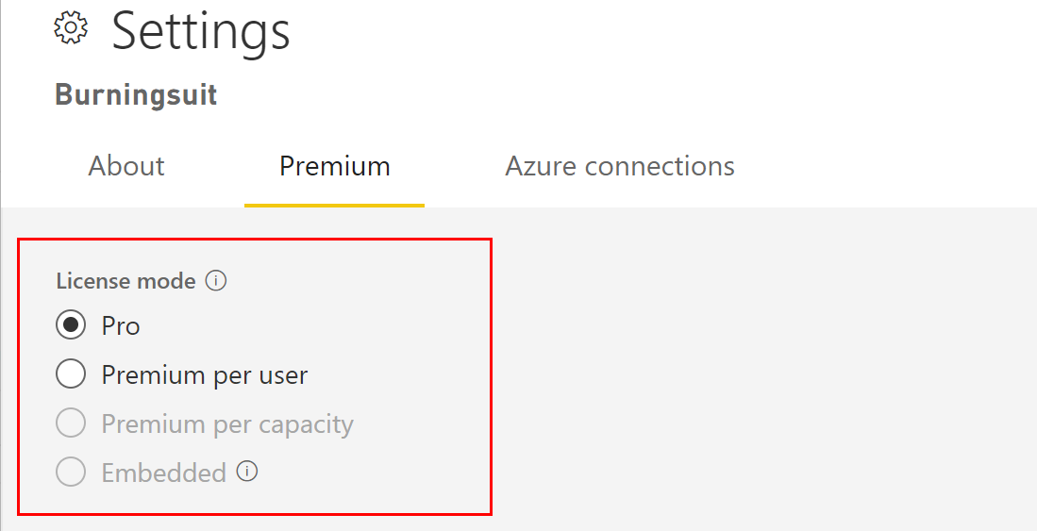
Introduction to Power BI Premium
Power BI Premium Per User
Power BI Premium Per User allows organizations to license premium features on a per-user basis.
Premium Per User(PPU) Includes all Power BI Pro license capabilities, and also adds features such as paginated reports, AI, and other capabilities that are only available to premium subscribers.

Slide 66
Introduction to Power BI Premium
Power BI Premium Features
Greater scale and performance for your power BI Reports.
Flexibility to license by capacity.
Best-in-class features for data visualization and insight-extraction such as AI-driven analysis, reusable data flows, and paginated reports.
Unify self-service and enterprise BI with a variety of Premium-only capabilities that support heavier workloads and require enterprise scale.
Built-in license to extend on-premises BI with Power BI Report Server.
Ability to share Power BI content with anyone (even outside your organization).

Slide 67
